Slide 1


“Online Exam System”
Submitted by: Parth Deshmukh
Submission type : Individual
Name: Parth Deshmukh
Batch : 12
LMS Id :
Program : Axis Fintech Full Stack Developer
Date: 1/06/2023
GIT Link : https://github.com/parthdeshmukh1911/online-exam-system/tree/main

Slide 2

Table of contents
Introduction
Project Overview
Architecture Design
User Interface Design
Back-end Development
Front-end Development
Conclusion
Future Work
References

Slide 3

Introduction
Introduction :
The Online Exam System is a web-based application designed to simplify the process of conducting online exams. This system allows educators to create and manage online exams, and students can take the.

Slide 4
Project Overview
Functionalities
Functionalities of the Teacher:
Create and manage exams
Create and manage questions
Monitor exam progress
Evaluate exam results
Analayze and review performance

Slide 5
Project Overview
Functionalities
Functionalities of the Student:
Prepare for exams
Take exams online
Follow exam rules and guidelines
Submit completed exams
Review exam results

Slide 6
Project Overview
Functionalities
Functionalities of the Admin:
Manage teacher accounts
Create, update, and delete teacher accounts
Ensure system security and access control

Slide 7
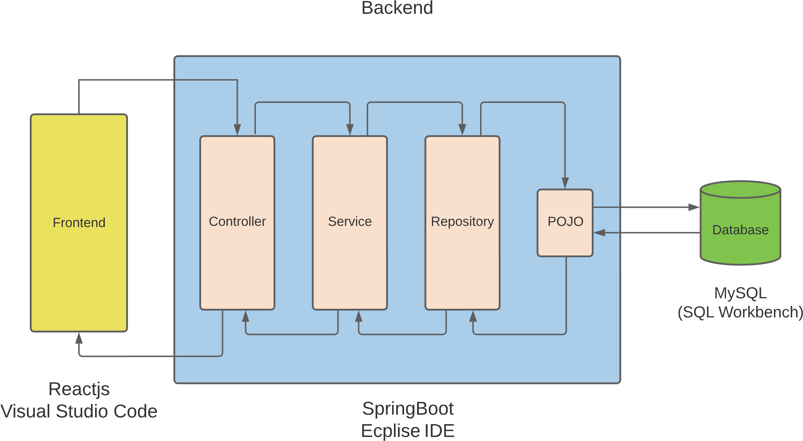
Architecture Design

Slide 8
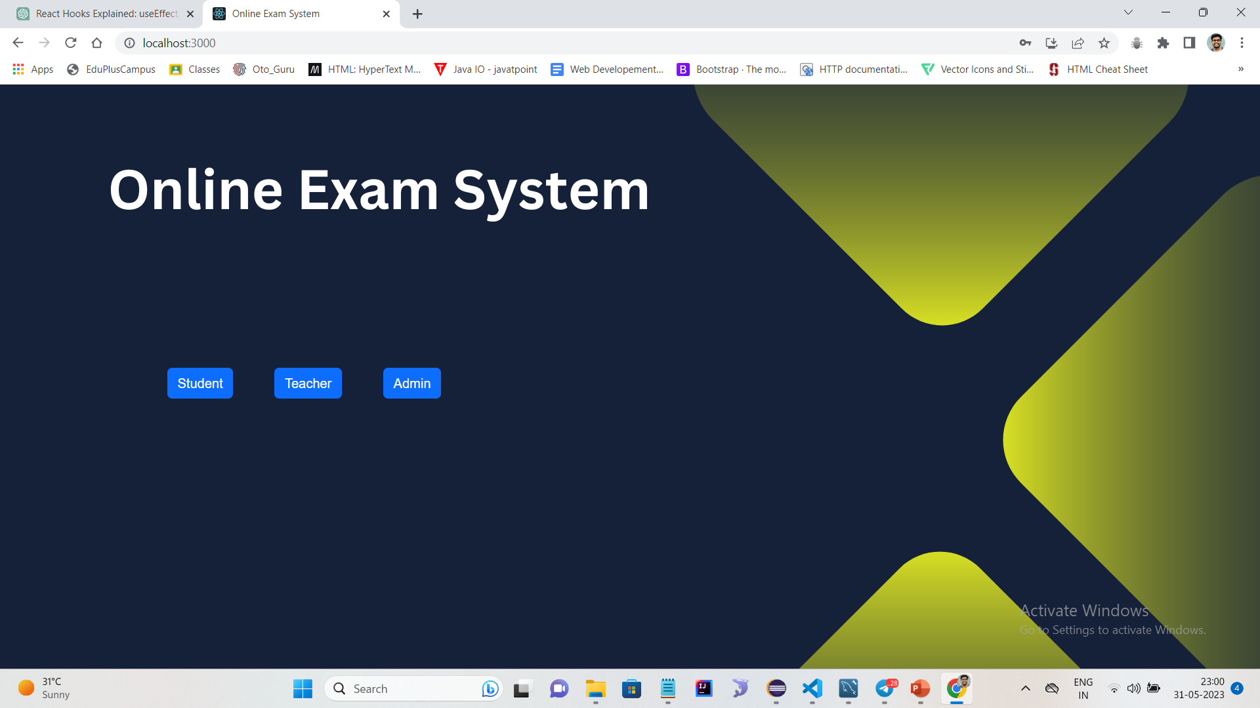
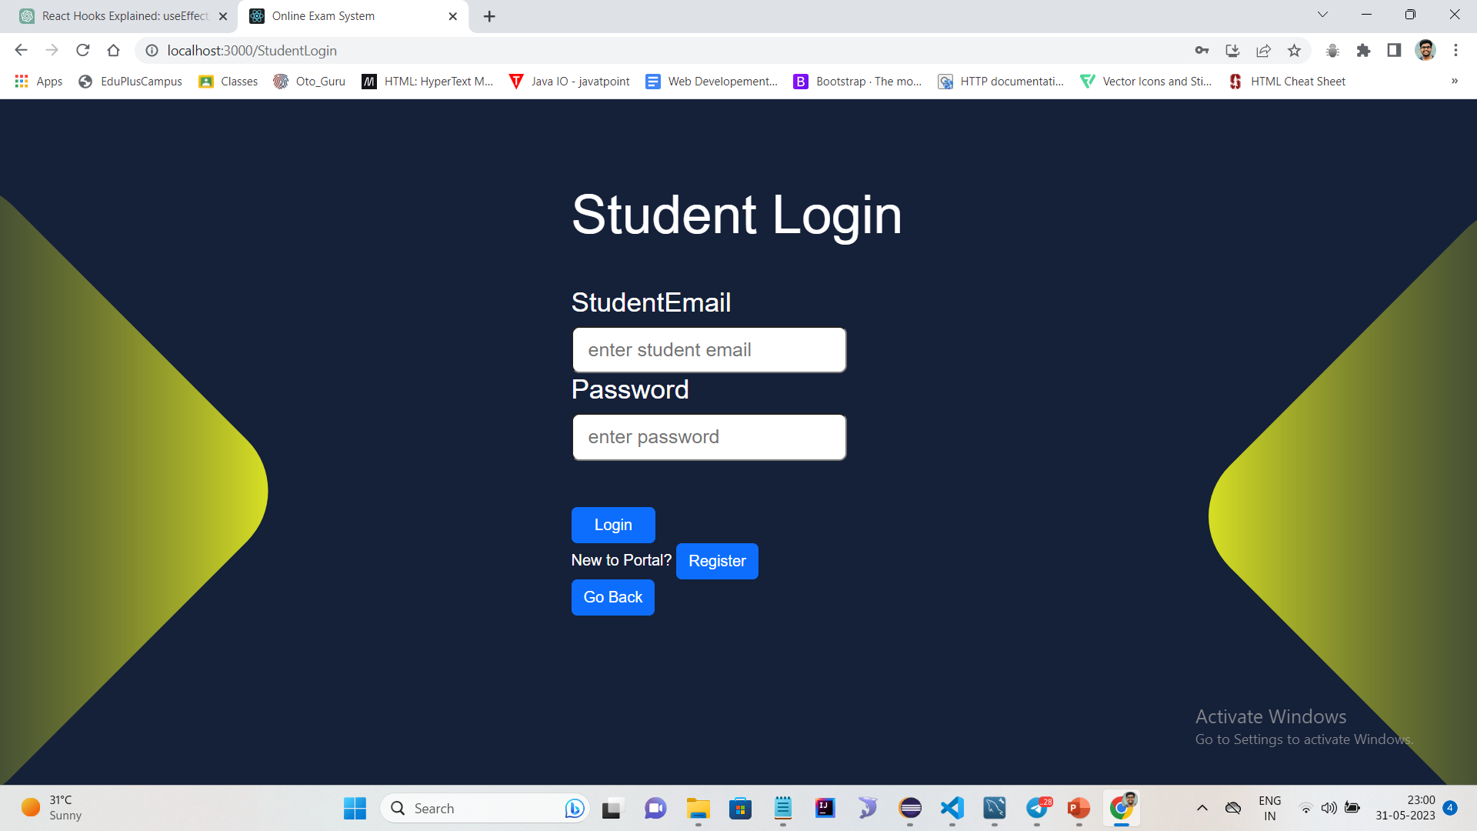
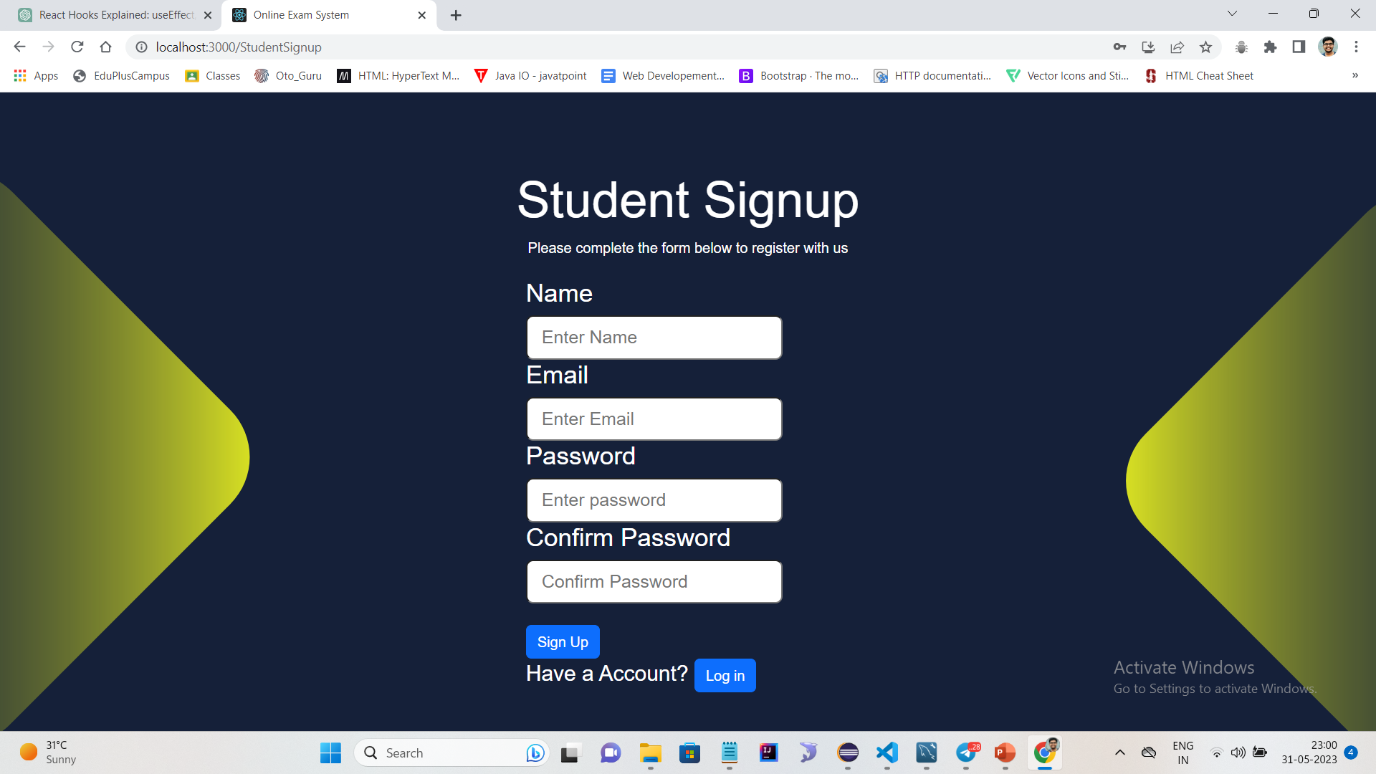
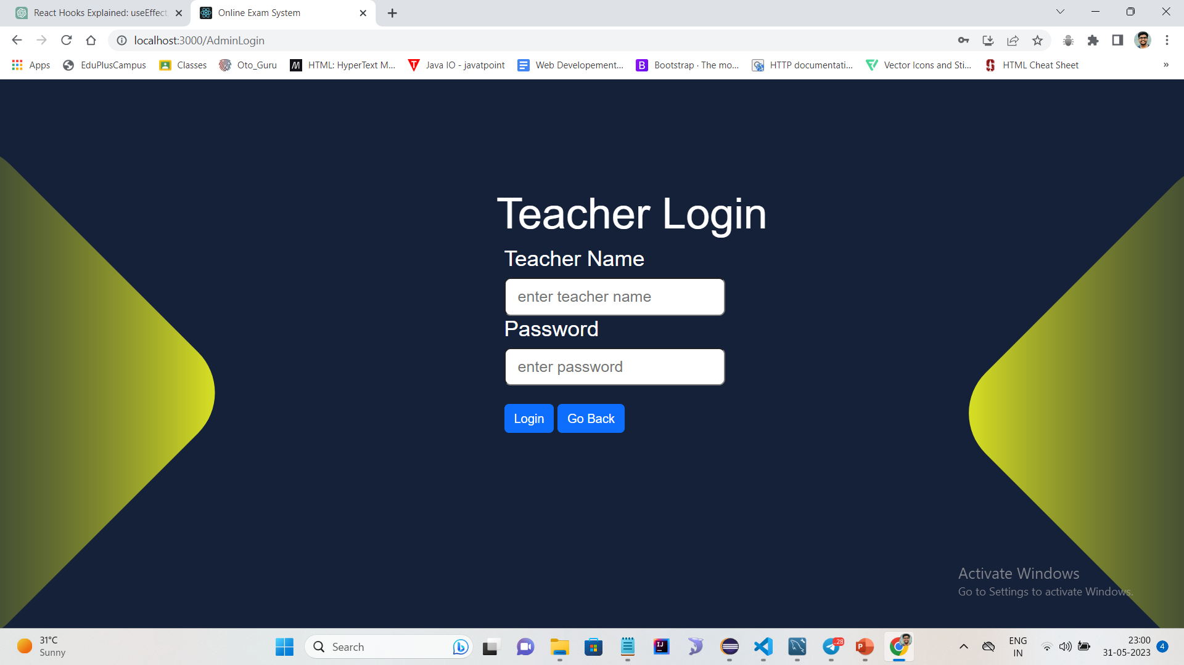
User Interface Design

Slide 9
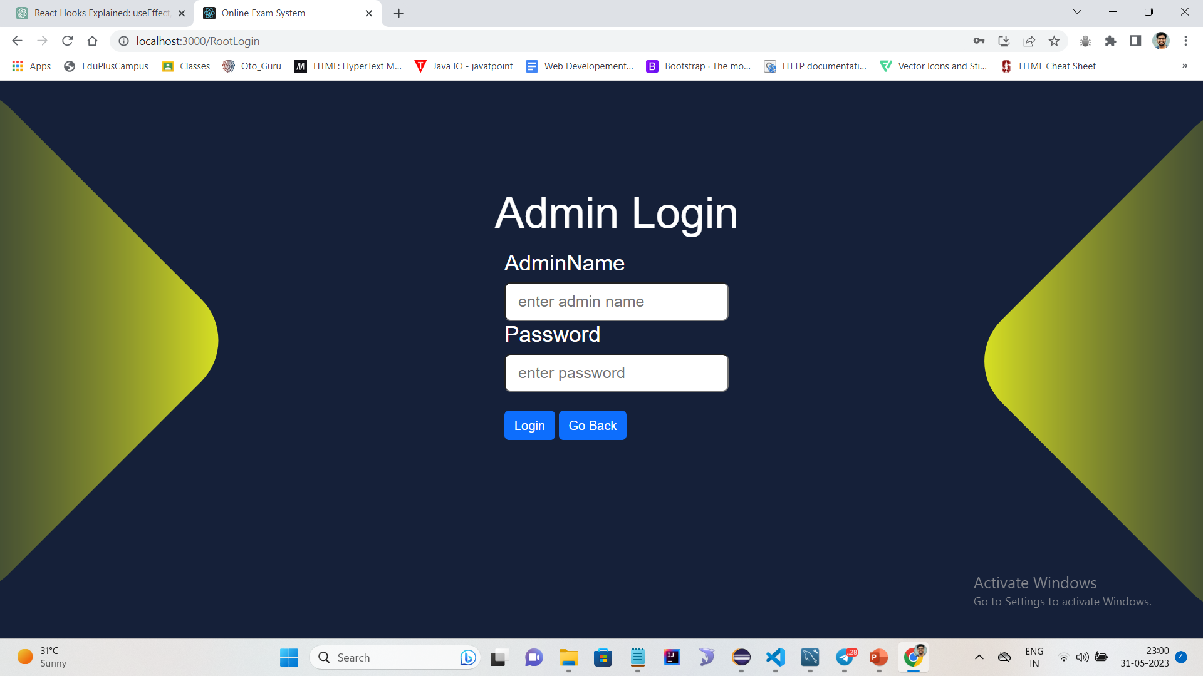
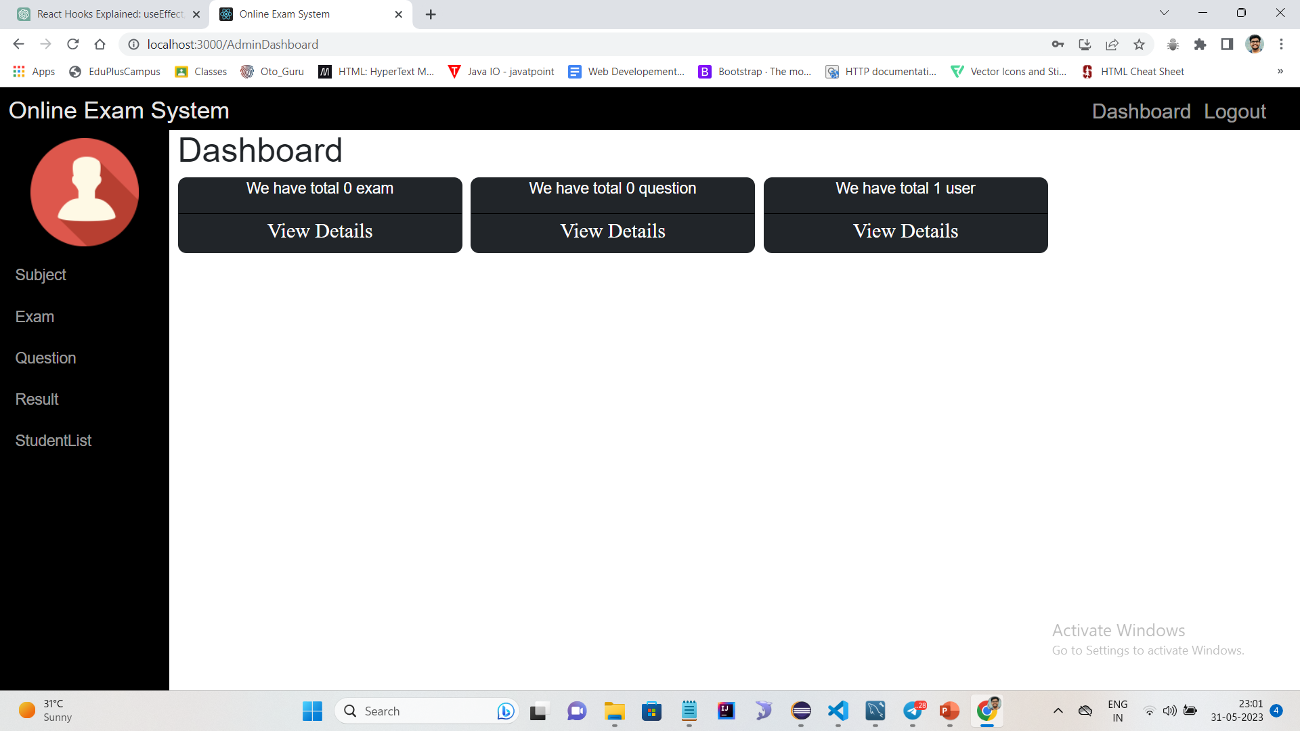
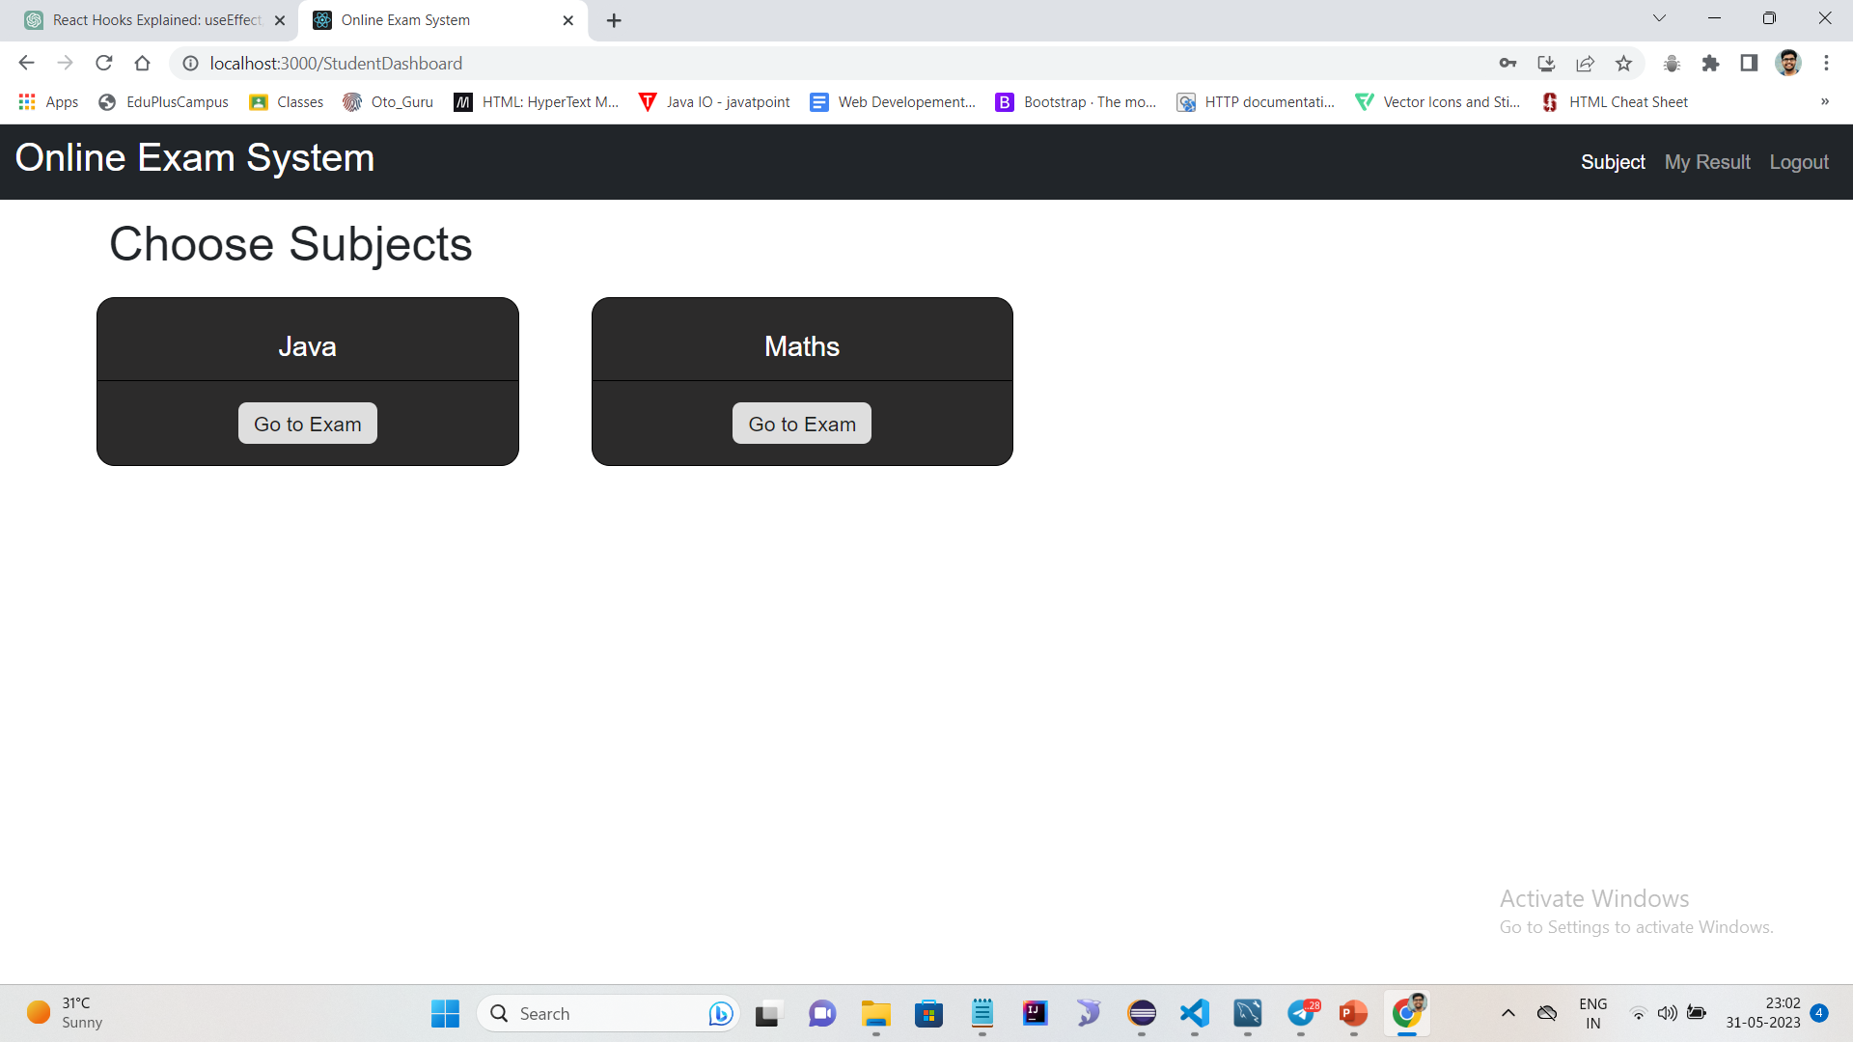
User Interface Design

Slide 10



Back-end Development
Technologies :
Spring Boot: Spring Boot is a Java framework that simplifies the development of stand-alone, production-grade Spring applications.
Hibernate: Hibernate is an object-relational mapping (ORM) framework for Java
Postman: For testing Crud operations.
Database: MySQL database.
Dependencies :
Spring Devtools
Spring web
MySQL Driver
Lombok
JPA

Slide 11
Back-end Development
Entity | Repository | Service Interface | Service Impl | Controller
Admin | AdminRepository | AdminService | AdminServiceImpl | AdminController
User | UserRepository | UserService | UserServiceImpl | UserController
Subject | SubjectRepository | SubjectService | SubjectServiceImpl | SubjectController
Exam | ExamRepository | ExamService | ExamServiceImpl | ExamController
MCQQuestion | MCQQuestionRepository | MCQQuestionService | MCQQuestionServiceImpl | MCQQuestionController
TFQuestion | TFQuestionRepository | TFQuestionService | TFQuestionServiceImpl | TFQuestionController
FBQuestion | FBQuestionRepository | FBQuestionService | FBQuestionServiceImpl | FBQuestionController
Result | ResultRepository | ResultService | ResultServiceImpl | ResultController

Slide 12



Front-end Development
Technologies :
React.js : ReactJS: ReactJS is a popular JavaScript library used for building user interfaces. It provides a component-based approach to development.
Axios: Axios is a widely used JavaScript library for making HTTP requests in the browser.
Bootstrap: Bootstrap is a popular open-source front-end framework that provides a collection of pre-built responsive design components and utilities.

Slide 13
Front-end Development
Admin Component | Root Components | Student Component
Admin Dashboard Dashboard ExamComponent AddQuestion DetailComponent ViewQuestion QuestionComponent ResultComponent StudentList Student SubjectComponent Admin Login | RootDashboard Teacher Student RootLogin | Student Component ExamComponenet ResultComponent Subject TestComponent Student Login Student SignUp

Slide 14
Conclusion
The Online Exam System is a web-based application designed to simplify the process of conducting online exams. The functional requirements include user management, exam management, exam taking, results management. The database design includes tables for admin, users, exams, multiple choise questions, true or false question, fill in blank question, result and subject.

Slide 15
Future Work
Future Scope :
Assay Question.
Feedback of Student.
Implementation of Spring Security.

Slide 16


